Slide 1
Practical Information Security Practices – Boot Camp Networking Review

Slide 2
Overview
Microsoft Baseline Security Analyzer
First version in Aug 2004
Tool used to inspect state of Windows machine
Checks for missing security updates
Checks several windows settings
Inspects user accounts
Gives advice on how to improve system security
Tool was developed after wave of Windows attacks
Download from Microsoft.com
Always ensure you have latest tool update

Slide 3
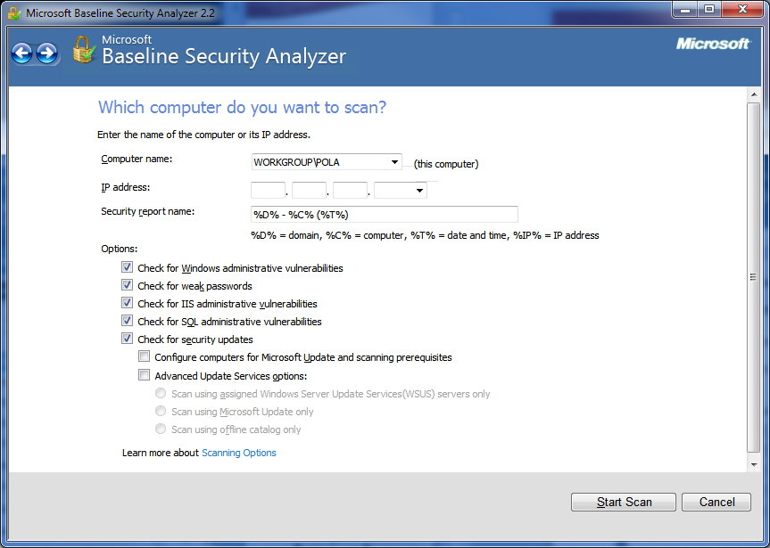
MBSA – Initial Screen

Slide 4
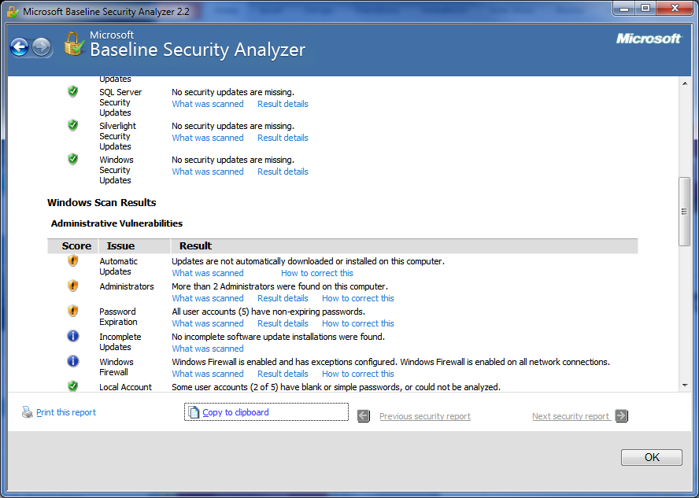
Demo - Interpreting Results

Slide 5
MBSA Value
Tells you what Microsoft Patches you need
Highlights open accounts & admins
Shows accounts with weak passwords
Additionally checks:
Audit/Logging settings
Unecessary Services
Open File Shares
If IIS Web server is installed
If SQL server is installed

Slide 6
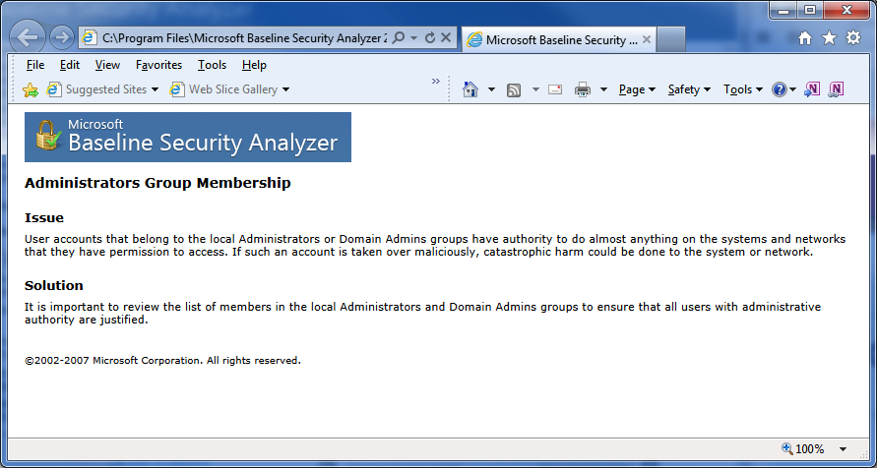
Issue Advice

Slide 7
Recap
Useful tool for Microsoft Systems
Price is in budget (free)
Run periodically (e.g. monthly) to protect system
Losing favor to tools with broader support such as:
Secunia PSI (highly recommend)
Shavlik – good for servers and large environment

